Slide 1


Hybrid Polystore Framework
Maxime Gobert
Loup Meurice
Supervised by Anthony Cleve

Slide 2
Context

Slide 3
Hybrid database system or polystore
Notes:
Hybrid databases system example
Evolution scenario and artefact to modify

Slide 4
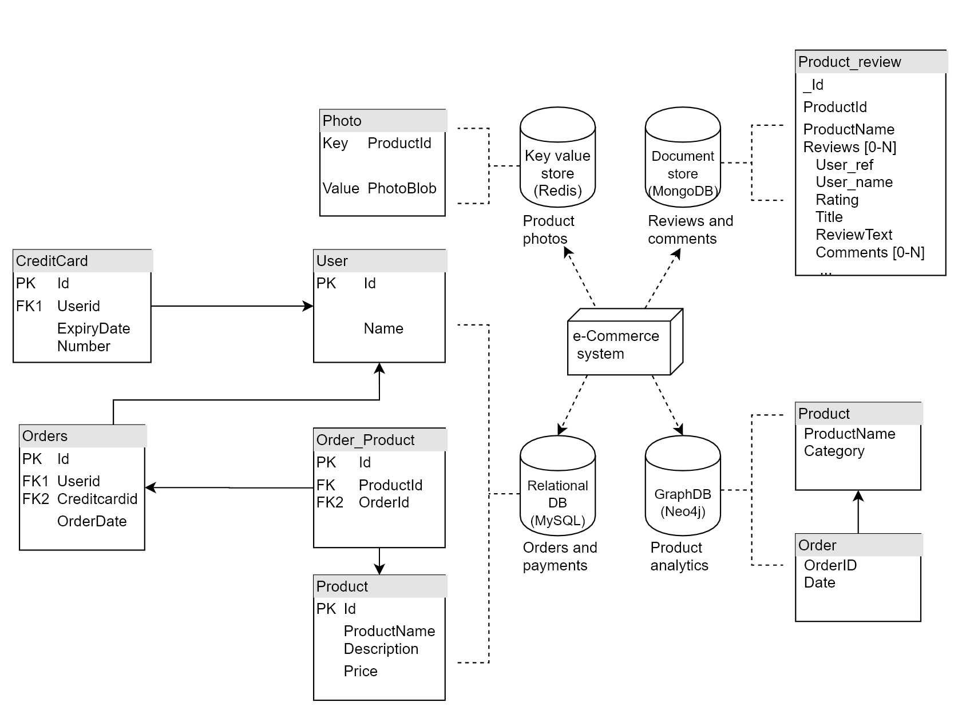
Notes:
Hybrid databases system example
Evolution scenario and artefact to modify

Slide 5
Notes:
Hybrid databases system example
Evolution scenario and artefact to modify

Slide 6
Notes:
Hybrid databases system example
Evolution scenario and artefact to modify

Slide 7
Notes:
Hybrid databases system example
Evolution scenario and artefact to modify

Slide 8
Notes:
Hybrid databases system example
Evolution scenario and artefact to modify

Slide 9
Physical schema
Notes:
Separated DB but not independent

Slide 10
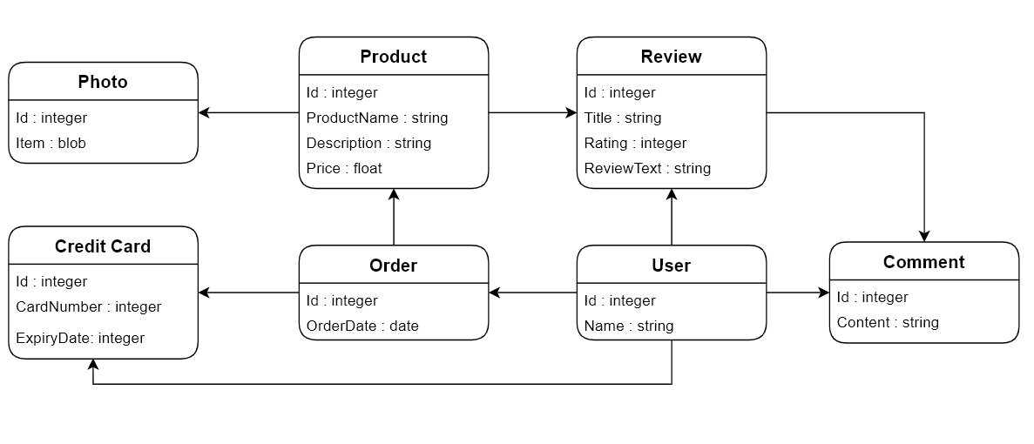
Conceptual Schema
Notes:
They rely on an implicit Conceptual schema

Slide 11
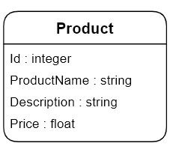
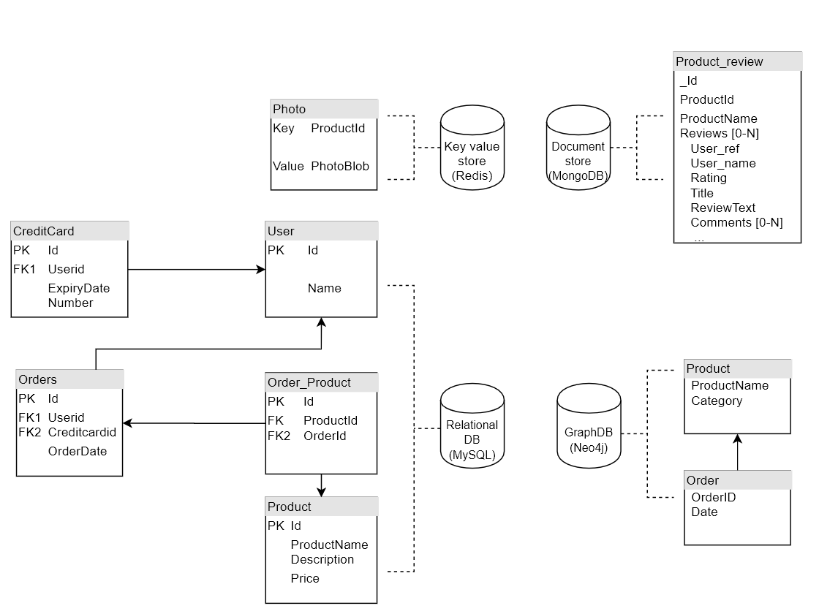
Notes:
Overlapping / redundancy / data duplication

Slide 12
Notes:
Overlapping / redundancy / data duplication

Slide 13
Notes:
Overlapping / redundancy / data duplication

Slide 14
Notes:
Overlapping / redundancy / data duplication

Slide 15
Notes:
Overlapping / redundancy / data duplication

Slide 16
Notes:
Overlapping / redundancy / data duplication

Slide 17
Data and Queries
Notes:
Hybrid databases system example
Evolution scenario and artefact to modify

Slide 18
Data and Queries
{
"_id": "5df8b60952264a01b6a8a2fc",
"productId": "product0",
"productName": "SuperCleaner3",
"reviews": [
{
"review_id": "review1",
"user_ref": "user55",
"user_name": "Serena",
"rating": 1,
"title": "Dont buy!!!",
"reviewText": "I dropped it from a 5 stories building and it broke!",
"comments": []
},
...
]
}
}
Notes:
Hybrid databases system example
Evolution scenario and artefact to modify

Slide 19
Data and Queries
{
"_id": "5df8b60952264a01b6a8a2fc",
"productId": "product0",
"productName": "SuperCleaner3",
"reviews": [
{
"review_id": "review1",
"user_ref": "user55",
"user_name": "Serena",
"rating": 1,
"title": "Dont buy!!!",
"reviewText": "I dropped it from a 5 stories building and it broke!",
"comments": []
},
...
]
}
}
DocumentDB dbcollection.find({productName:"SuperCleaner3"})
Notes:
Hybrid databases system example
Evolution scenario and artefact to modify

Slide 20
Data and Queries
{
"_id": "5df8b60952264a01b6a8a2fc",
"productId": "product0",
"productName": "SuperCleaner3",
"reviews": [
{
"review_id": "review1",
"user_ref": "user55",
"user_name": "Serena",
"rating": 1,
"title": "Dont buy!!!",
"reviewText": "I dropped it from a 5 stories building and it broke!",
"comments": []
},
...
]
}
}
DocumentDB dbcollection.find({productName:"SuperCleaner3"})
GraphDB
match (n:Product{productName:“SuperCleaner3"})<--(o:Order)-->(otherProducts:Product) return n,o,otherProducts
Notes:
Hybrid databases system example
Evolution scenario and artefact to modify

Slide 21
Data and Queries
{
"_id": "5df8b60952264a01b6a8a2fc",
"productId": "product0",
"productName": "SuperCleaner3",
"reviews": [
{
"review_id": "review1",
"user_ref": "user55",
"user_name": "Serena",
"rating": 1,
"title": "Dont buy!!!",
"reviewText": "I dropped it from a 5 stories building and it broke!",
"comments": []
},
...
]
}
}
DocumentDB dbcollection.find({productName:"SuperCleaner3"})
GraphDB
match (n:Product{productName:“SuperCleaner3"})<--(o:Order)-->(otherProducts:Product) return n,o,otherProducts
Relational DB
Select userid from Orders O JOIN Order_Product OP ON O.Id=OP.OrderId JOIN Product P ON OP.ProductId=P.Id where P.productName=“SuperClean3”
Notes:
Hybrid databases system example
Evolution scenario and artefact to modify

Slide 22
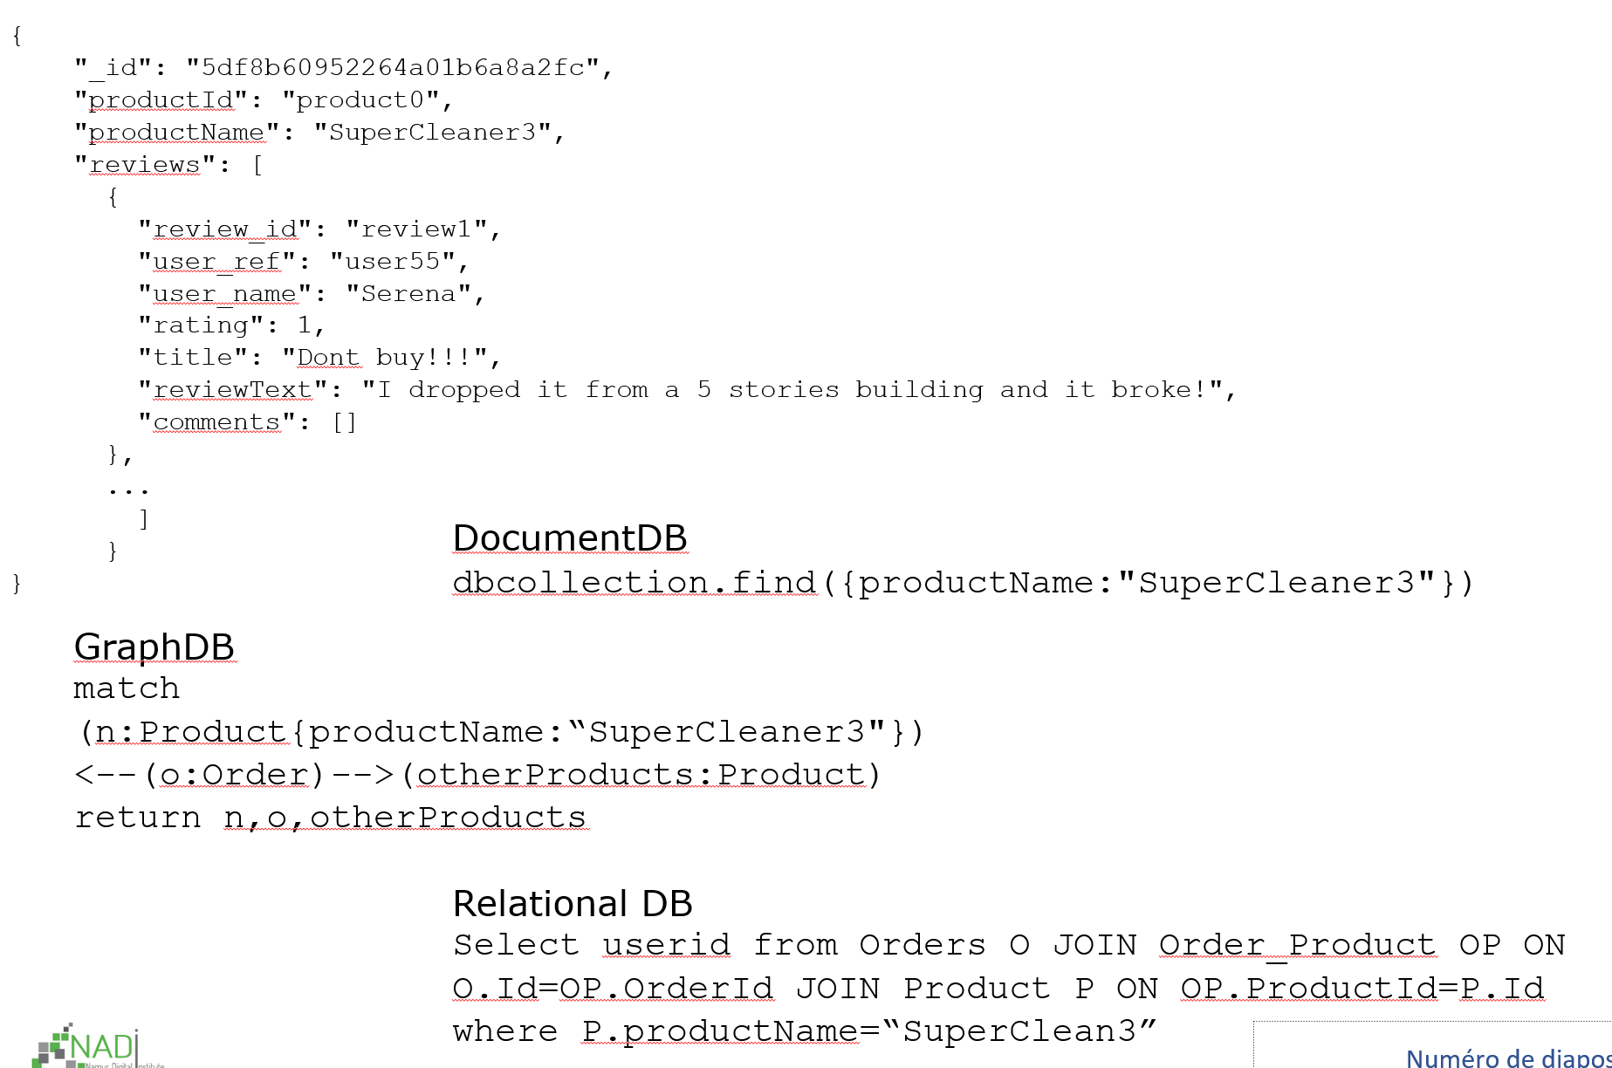
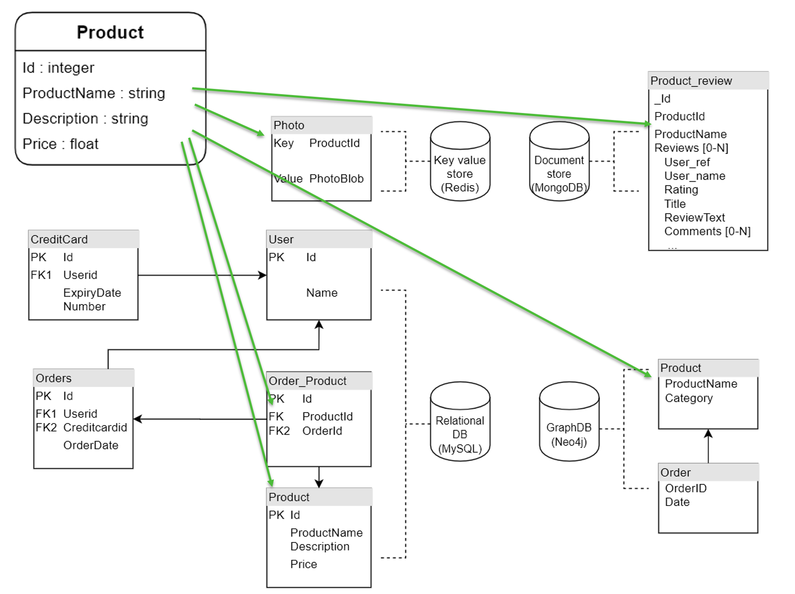
Hybrid database system
Notes:
Hybrid databases system example
Evolution scenario and artefact to modify

Slide 23
Hybrid Polystore Framework

Slide 24
Our approach
Focuses on multi databases systems, or polystores, possibly with heterogeneous data models
For such systems our framework will help with :
The conceptual design
The physical structure design
The mapping between them
The generation of ready to use access code
The evolution of artefacts when requirements evolve
Notes:
Research questions

Slide 25
Design

Slide 26
Unified Model
Conceptual
Physical
Mapping

Slide 27
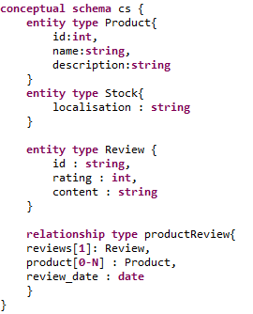
Unified Model
Conceptual
Physical
Mapping

Slide 28
Unified Model
Conceptual
Physical
Mapping

Slide 29
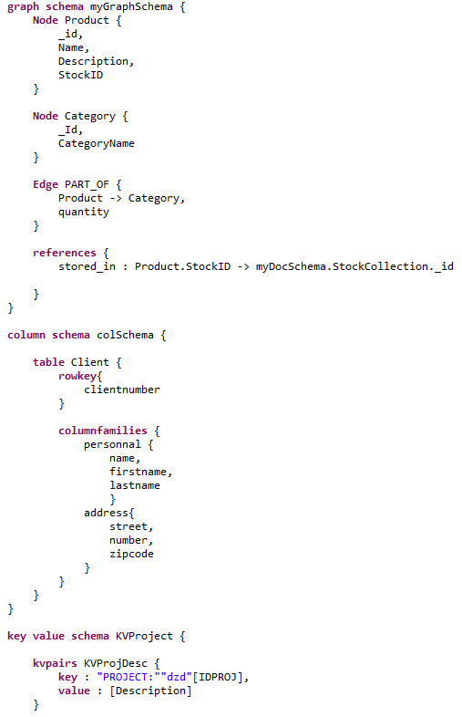
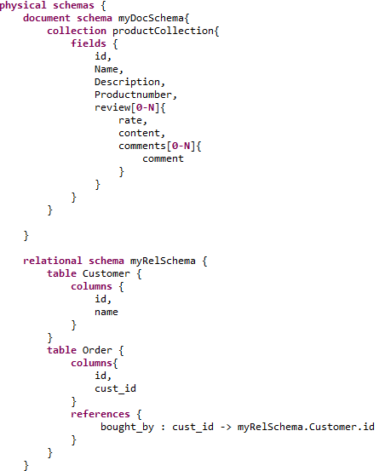
Unified Model

Slide 30
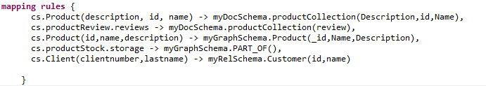
Unified Model
Conceptual
Physical
Mapping

Slide 31
Code generation

Slide 32
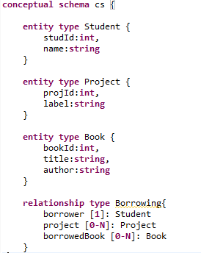
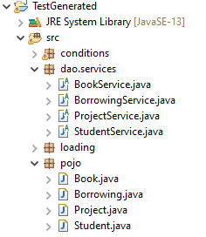
Example
Polystore Model
Acceleo Code Generation
Access Services
Data objects

Slide 33
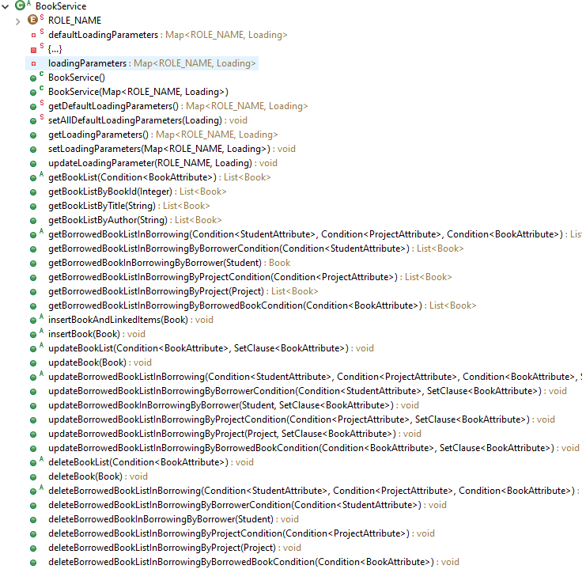
Service

Slide 34
Implementation
Depending on the mapping the implementation of services methods will produce corresponding queries

Slide 35
Implementation
Depending on the mapping the implementation of services methods will produce corresponding queries
DocumentDB dbcollection.find({productName:"SuperCleaner3"})
GraphDB
match (n:Product{productName:“SuperCleaner3"})<--(o:Order)-->(otherProducts:Product) return n,o,otherProducts
Relational DB
Select userid from Orders O JOIN Order_Product OP ON O.Id=OP.OrderId JOIN Product P ON OP.ProductId=P.Id where P.productName=“SuperClean3”

Slide 36
Evolution Scenario

Slide 37
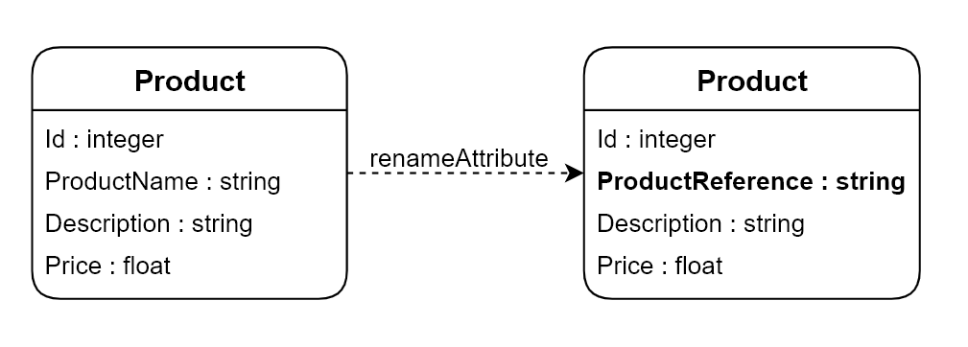

Slide 38
Conceptual Schema Impact
Notes:
Hybrid databases system example
Evolution scenario and artefact to modify

Slide 39
Physical Schema Impact
Notes:
Hybrid databases system example
Evolution scenario and artefact to modify

Slide 40
Physical Schema Impact
Notes:
Hybrid databases system example
Evolution scenario and artefact to modify

Slide 41
Physical Schema Impact
Notes:
Hybrid databases system example
Evolution scenario and artefact to modify

Slide 42
Data and Queries
{
"_id": "5df8b60952264a01b6a8a2fc",
"productId": "product0",
"productName": "SuperCleaner3",
"reviews": [
{
"review_id": "review1",
"user_ref": "user55",
"user_name": "Serena",
"rating": 1,
"title": "Dont buy!!!",
"reviewText": "I dropped it from a 5 stories building and it broke!",
"comments": []
},
...
]
}
}
DocumentDB dbcollection.find({productName:"SuperCleaner3"})
GraphDB
match (n:Product{productName:“SuperCleaner3"})<--(o:Order)-->(otherProducts:Product) return n,o,otherProducts
Relational DB
Select userid from Orders O JOIN Order_Product OP ON O.Id=OP.OrderId JOIN Product P ON OP.ProductId=P.Id where P.productName=“SuperClean3”
Notes:
Hybrid databases system example
Evolution scenario and artefact to modify

Slide 43
Data and Queries
{
"_id": "5df8b60952264a01b6a8a2fc",
"productId": "product0",
"productName": "SuperCleaner3",
"reviews": [
{
"review_id": "review1",
"user_ref": "user55",
"user_name": "Serena",
"rating": 1,
"title": "Dont buy!!!",
"reviewText": "I dropped it from a 5 stories building and it broke!",
"comments": []
},
...
]
}
}
DocumentDB dbcollection.find({productName:"SuperCleaner3"})
GraphDB
match (n:Product{productName:“SuperCleaner3"})<--(o:Order)-->(otherProducts:Product) return n,o,otherProducts
Relational DB
Select userid from Orders O JOIN Order_Product OP ON O.Id=OP.OrderId JOIN Product P ON OP.ProductId=P.Id where P.productName=“SuperClean3”
Notes:
Hybrid databases system example
Evolution scenario and artefact to modify

Slide 44
Data and Queries
{
"_id": "5df8b60952264a01b6a8a2fc",
"productId": "product0",
"productName": "SuperCleaner3",
"reviews": [
{
"review_id": "review1",
"user_ref": "user55",
"user_name": "Serena",
"rating": 1,
"title": "Dont buy!!!",
"reviewText": "I dropped it from a 5 stories building and it broke!",
"comments": []
},
...
]
}
}
DocumentDB dbcollection.find({productName:"SuperCleaner3"})
GraphDB
match (n:Product{productName:“SuperCleaner3"})<--(o:Order)-->(otherProducts:Product) return n,o,otherProducts
Relational DB
Select userid from Orders O JOIN Order_Product OP ON O.Id=OP.OrderId JOIN Product P ON OP.ProductId=P.Id where P.productName=“SuperClean3”
Notes:
Hybrid databases system example
Evolution scenario and artefact to modify

Slide 45
Data and Queries
{
"_id": "5df8b60952264a01b6a8a2fc",
"productId": "product0",
"productName": "SuperCleaner3",
"reviews": [
{
"review_id": "review1",
"user_ref": "user55",
"user_name": "Serena",
"rating": 1,
"title": "Dont buy!!!",
"reviewText": "I dropped it from a 5 stories building and it broke!",
"comments": []
},
...
]
}
}
DocumentDB dbcollection.find({productName:"SuperCleaner3"})
GraphDB
match (n:Product{productName:“SuperCleaner3"})<--(o:Order)-->(otherProducts:Product) return n,o,otherProducts
Relational DB
Select userid from Orders O JOIN Order_Product OP ON O.Id=OP.OrderId JOIN Product P ON OP.ProductId=P.Id where P.productName=“SuperClean3”
Notes:
Hybrid databases system example
Evolution scenario and artefact to modify

Slide 46
Data and Queries
{
"_id": "5df8b60952264a01b6a8a2fc",
"productId": "product0",
"productName": "SuperCleaner3",
"reviews": [
{
"review_id": "review1",
"user_ref": "user55",
"user_name": "Serena",
"rating": 1,
"title": "Dont buy!!!",
"reviewText": "I dropped it from a 5 stories building and it broke!",
"comments": []
},
...
]
}
}
DocumentDB dbcollection.find({productName:"SuperCleaner3"})
GraphDB
match (n:Product{productName:“SuperCleaner3"})<--(o:Order)-->(otherProducts:Product) return n,o,otherProducts
Relational DB
Select userid from Orders O JOIN Order_Product OP ON O.Id=OP.OrderId JOIN Product P ON OP.ProductId=P.Id where P.productName=“SuperClean3”
Notes:
Hybrid databases system example
Evolution scenario and artefact to modify

Slide 47
Schema evolution
Schema evolution is the ability to change deployed
schemas, i.e., metadata structures formally describing
complex artifacts such as databases, messages, application
programs or workflows.[1]
[1]Erhard Rahm and Philip A. Bernstein. 2006. An online bibliography on schema evolution. SIGMOD Rec. 35, 4 (December 2006), 30–31. DOI:https://doi.org/10.1145/1228268.1228273
Notes:
Research questions

Slide 48
Schema evolution
Schema evolution is the ability to change deployed
schemas, i.e., metadata structures formally describing
complex artifacts such as databases, messages, application
programs or workflows.[1]
Very large litterature on relational databases. (e.g PRISM++ by Curino [2])
[1]Erhard Rahm and Philip A. Bernstein. 2006. An online bibliography on schema evolution. SIGMOD Rec. 35, 4 (December 2006), 30–31. DOI:https://doi.org/10.1145/1228268.1228273
[2] Curino, C., Moon, H. J., Deutsch, A., & Zaniolo, C. (2013). Automating the database schema evolution process. The VLDB Journal, 22(1), 73-98. process. The VLDB Journal, 22(1):73–98, February 2013
Notes:
Research questions

Slide 49
Schema evolution
Schema evolution is the ability to change deployed
schemas, i.e., metadata structures formally describing
complex artifacts such as databases, messages, application
programs or workflows.[1]
Very large litterature on relational databases. (e.g PRISM++ by Curino [2])
New on NoSQL, problems listing and early solutions (e.g Scherzinger [3])
[1]Erhard Rahm and Philip A. Bernstein. 2006. An online bibliography on schema evolution. SIGMOD Rec. 35, 4 (December 2006), 30–31. DOI:https://doi.org/10.1145/1228268.1228273
[2] Curino, C., Moon, H. J., Deutsch, A., & Zaniolo, C. (2013). Automating the database schema evolution process. The VLDB Journal, 22(1), 73-98. process. The VLDB Journal, 22(1):73–98, February 2013
[3] Scherzinger, S., Klettke, M., & Störl, U. (2013). Managing schema evolution in NoSQL data stores. arXiv preprint arXiv:1308.0514.
Notes:
Research questions

Slide 50
Schema evolution
Schema evolution is the ability to change deployed
schemas, i.e., metadata structures formally describing
complex artifacts such as databases, messages, application
programs or workflows.[1]
Very large litterature on relational databases. (e.g PRISM++ by Curino [2])
New on NoSQL, problems listing and early solutions (e.g Scherzinger [3])
Mono store systems
[1]Erhard Rahm and Philip A. Bernstein. 2006. An online bibliography on schema evolution. SIGMOD Rec. 35, 4 (December 2006), 30–31. DOI:https://doi.org/10.1145/1228268.1228273
[2] Curino, C., Moon, H. J., Deutsch, A., & Zaniolo, C. (2013). Automating the database schema evolution process. The VLDB Journal, 22(1), 73-98. process. The VLDB Journal, 22(1):73–98, February 2013
[3] Scherzinger, S., Klettke, M., & Störl, U. (2013). Managing schema evolution in NoSQL data stores. arXiv preprint arXiv:1308.0514.
Notes:
Research questions

Slide 51
Our approach aims to :
Evolve multi databases systems, or polystores, possibly with heterogeneous data models
Notes:
Research questions

Slide 52
Our approach aims to :
Evolve multi databases systems, or polystores, possibly with heterogeneous data models
Specify generic schema evolution operators to apply at the conceptual level
Notes:
Research questions

Slide 53
Our approach aims to :
Evolve multi databases systems, or polystores, possibly with heterogeneous data models
Specify generic schema evolution operators to apply at the conceptual level
Those operators will simultaneously manipulate the conceptual model, the physical schema, the mapping between them and the data and queries
A single operator can imply one or several databases of one or several heterogeneous data models
Notes:
Research questions

Slide 54
Evolution Framework

Slide 55
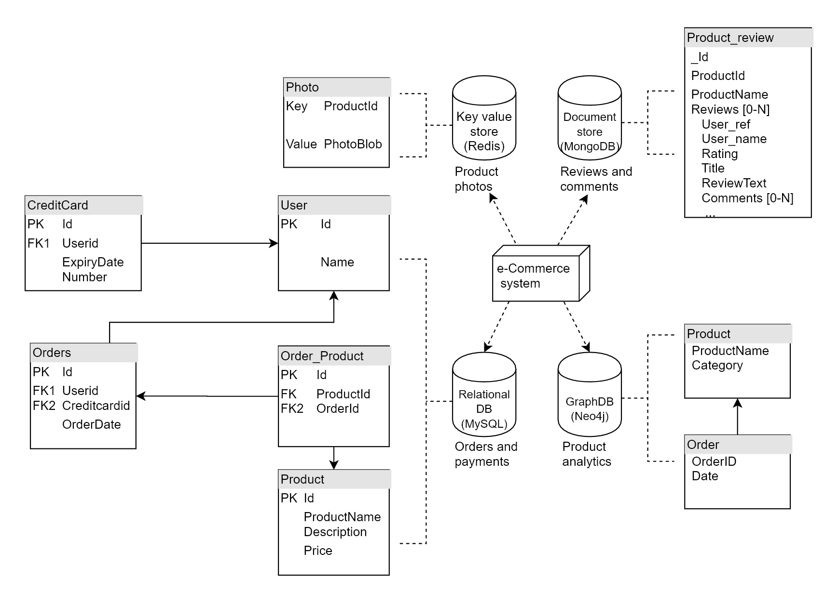
Source Conceptual Schema
Source Physical Schema
Source Data & Queries

Slide 56
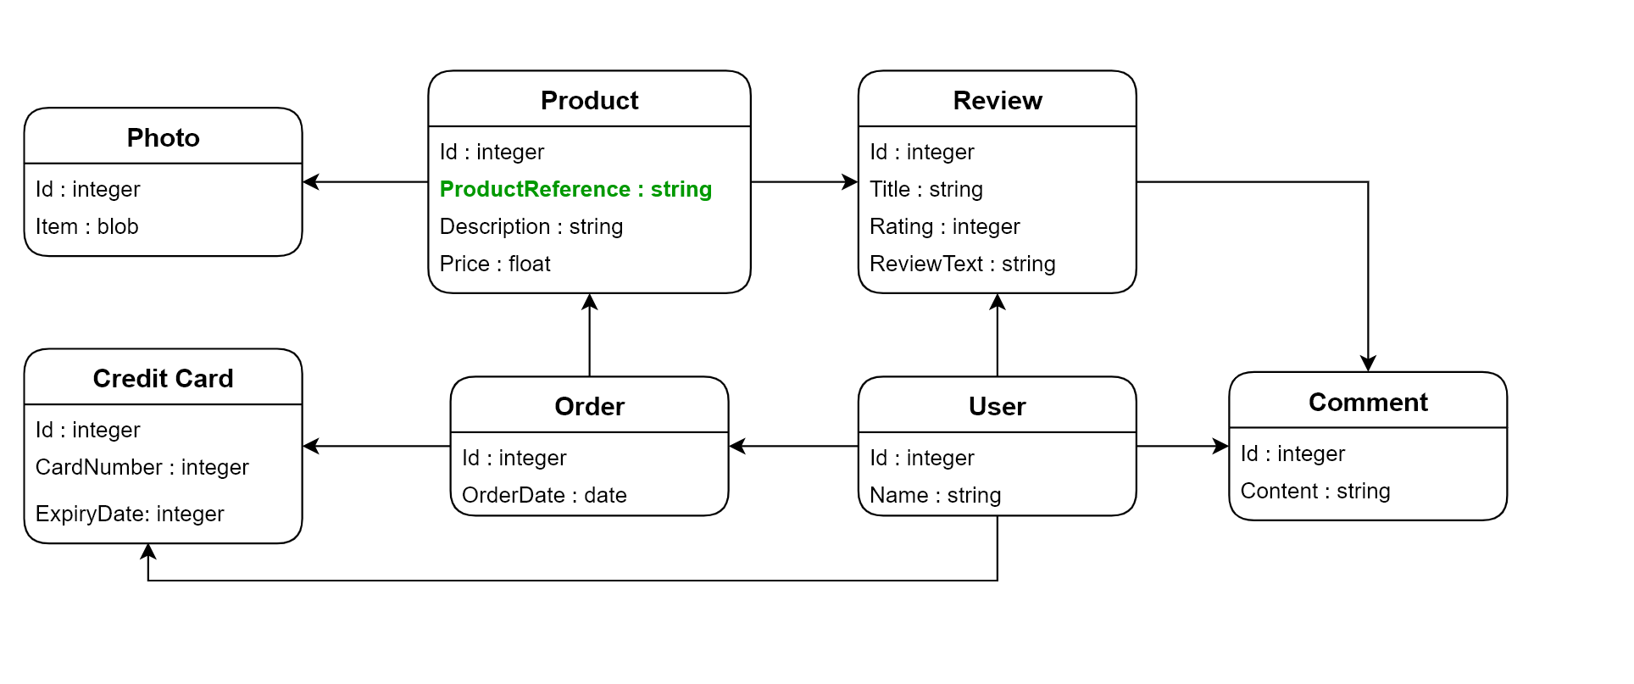
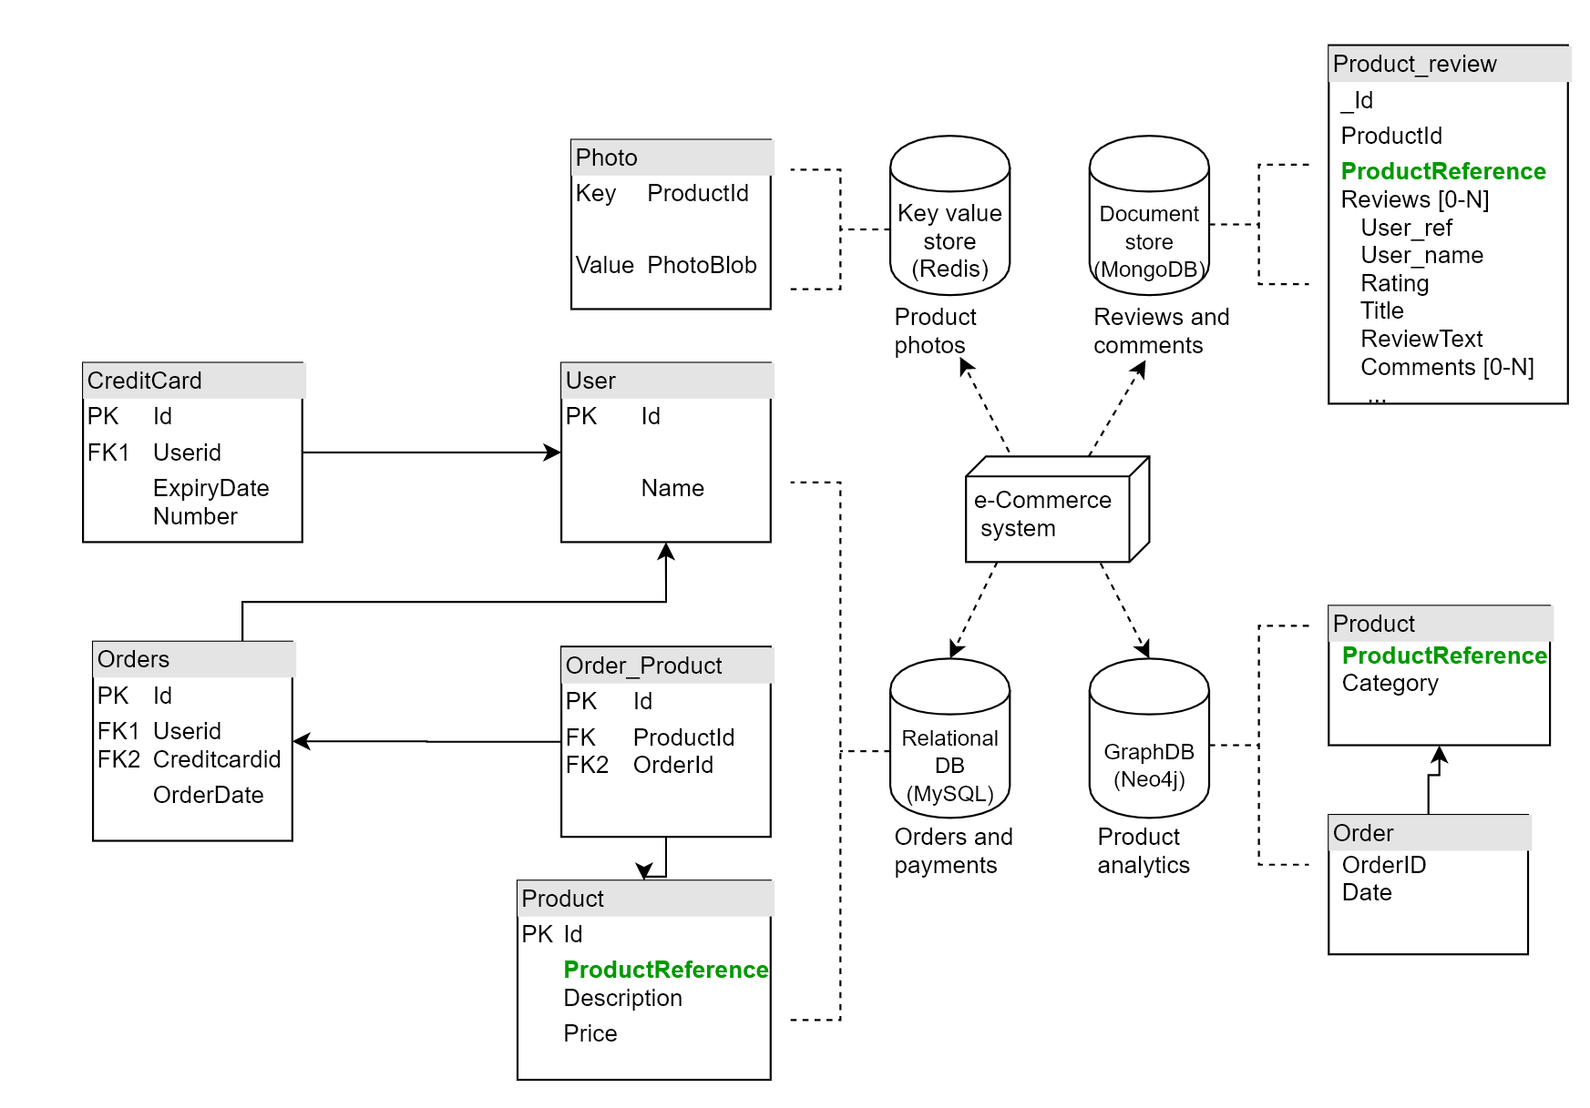
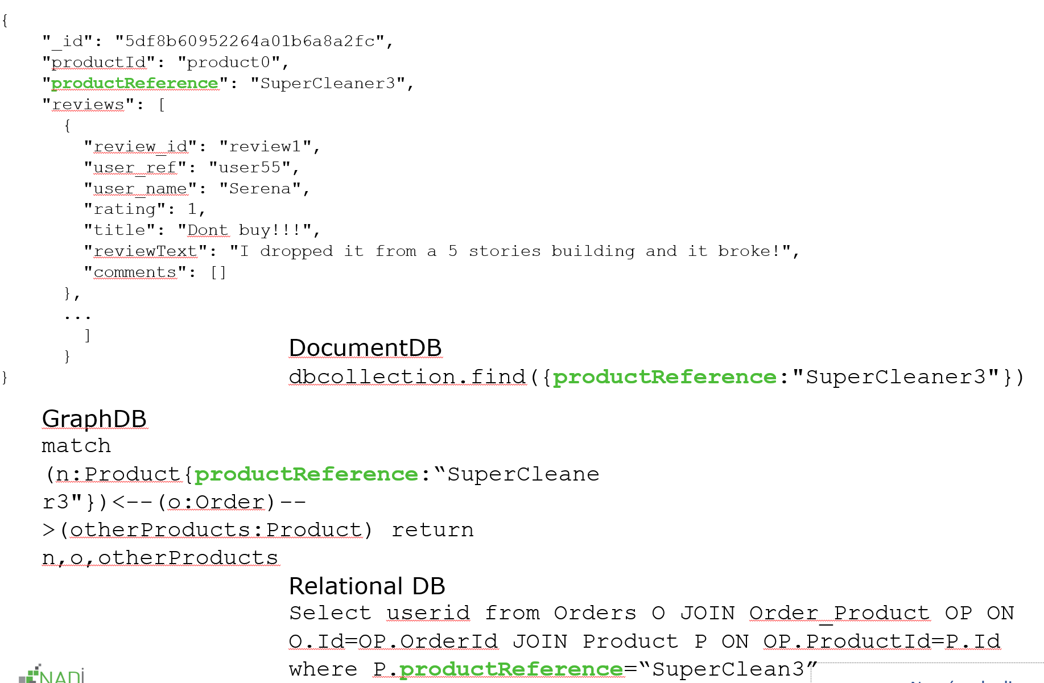
Source Conceptual Schema
Target Conceptual Schema
Source Physical Schema
Target Physical Schema
Source Data & Queries
Target Data & Queries

Slide 57
Source Conceptual Schema
Target Conceptual Schema
Source Physical Schema
Target Physical Schema
Model language for conceptual & physical schema
Source Data & Queries
Target Data & Queries

Slide 58
Source Conceptual Schema
Target Conceptual Schema
Source Physical Schema
Target Physical Schema
Model language for conceptual & physical schema
Mapping rules between them
Source Data & Queries
Target Data & Queries
Notes:
- Mapping rules in order to represent the differnet data modelling strategies.

Slide 59
Source Conceptual Schema
Target Conceptual Schema
Source Physical Schema
Target Physical Schema
Model language for conceptual & physical schema
Mapping rules between them
Evolution Operators
Source Data & Queries
Target Data & Queries

Slide 60
Model language for conceptual & physical schema
Mapping rules between them
Evolution Operators

Slide 61
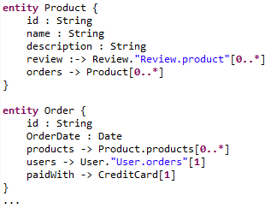
Conceptual model
Notes:
Research questions

Slide 62
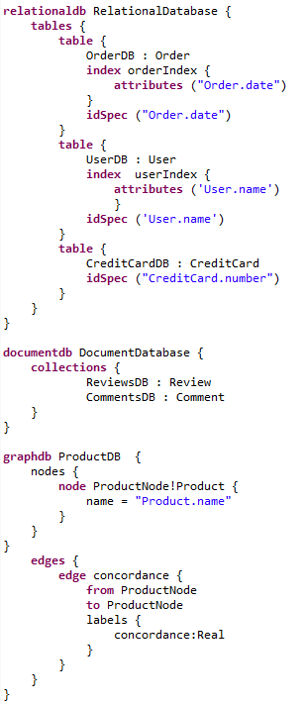
Physical model
Conceptual model
Transformation rules
Notes:
Research questions

Slide 63
Model language for conceptual & physical schema
Mapping rules between them
Evolution Operators

Slide 64
Evolution Operators
Operations of evolution to perform on conceptual model
Add entity, rename attribute, add relationship, migrate, ...
Notes:
Research questions

Slide 65
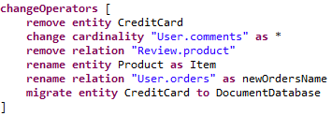
Evolution Operators
Operations of evolution to perform on conceptual model
Add entity, rename attribute, add relationship, migrate, ...
Notes:
Research questions

Slide 66
Evolution Operators
Operations of evolution to perform on conceptual model
Add entity, rename attribute, add relationship, migrate, ...
That specify the manipulations to perform on artefacts :
Conceptual model
Physical structures
The mapping between them
Data
Queries
Notes:
Research questions

Slide 67
Evolution Operators
Model Object | Operator | Conceptual Impact | Physical Schema Impact | Data Impact | Queries Impact
Entity Type | Add | addEntity(...) | A_{rel} A_{doc} | - | -
A_{rel} Execute SQL Create table statement
A_{doc} Execute Create collection statement
Notes:
Research questions

Slide 68
Evolution Operators
Model Object | Operator | Conceptual Impact | Physical Schema Impact | Data Impact | Queries Impact
Entity Type | Add | addEntity(...) | A_{rel} A_{doc} | - | -
Attribute | Rename | renameAtt(...) | U_{rel} U_{col}
A_{rel} Execute SQL Create table statement
A_{doc} Execute Create collection statement
U_{rel} Execute SQL alter table statement
U_{col} Execute CQL alter table statement
Notes:
Research questions

Slide 69
Evolution Operators
Model Object | Operator | Conceptual Impact | Physical Schema Impact | Data Impact | Queries Impact
Entity Type | Add | addEntity(...) | A_{rel} A_{doc} | - | -
Attribute | Rename | renameAtt(...) | U_{rel} U_{col} | UD_{doc} UD_{key} UD_{graph} | renameAtt(queries)
A_{rel} Execute SQL Create table statement
A_{doc} Execute Create collection statement
U_{rel} Execute SQL alter table statement
U_{col} Execute CQL alter table statement
UD_{doc} Execute rename statement
UD_{key} Delete and add new key value pairs
UD_{graph} Modify nodes
Notes:
Research questions

Slide 70
Evolution Operators
Model Object | Operator | Conceptual Impact | Physical Schema Impact | Data Impact | Queries Impact
Entity Type | Add | addEntity(...) | A_{rel} A_{doc} | - | -
Attribute | Rename | renameAtt(...) | U_{rel} U_{col} | UD_{doc} UD_{key} UD_{graph} | renameAtt(queries)
...
A_{rel} Execute SQL Create table statement
A_{doc} Execute Create collection statement
U_{rel} Execute SQL alter table statement
U_{col} Execute CQL alter table statement
UD_{doc} Execute rename statement
UD_{key} Delete and add new key value pairs
UD_{graph} Modify nodes
Notes:
Research questions

Slide 71
Wrap-up

Slide 72
Contribution of this approach
Developers can model multiple/heterogenous database system

Slide 73
Contribution of this approach
Developers can model multiple/heterogenous database system
Mapping rules between conceptual and physical schema allows database specific data representation strategies
Mapping rules allows multi database persistency of entities (overlapping, splitting, duplication)

Slide 74
Contribution of this approach
Developers can model multiple/heterogenous database system
Mapping rules between conceptual and physical schema allows database specific data representation strategies
Mapping rules allows multi database persistency of entities (overlapping, splitting, duplication)
Evolution is done via a unique entry point
Software artefacts are kept consistent with the evolution and with each other

Slide 75
Current status
18 evolution operators specified and implemented in EU H2020 project
On relational and document oriented data models only
Notes:
Research questions

Slide 76
Current status
18 evolution operators specified and implemented in EU H2020 project
On relational and document oriented data models only
Future work
Evaluation from the industrial partner of the project
Further specification for other data models
Investigate the integration of other data representation strategies and data migration strategies, extension of the unified data model
Generation of simple data access object
Notes:
Research questions

Slide 77
Thank you

